Slide 1


SmsDome – Database Marketing (SMS / MMS / EDM):
SINGTEL MEDIA
Updated: 24th June 2022
SmsDome Pte Ltd
T: +65 6767 3663
F: +65 6354 1339
E: info@smsdome.com
A: 47 Jalan Pemimpin, Halcyon 2, #03-01, Singapore 577200

Slide 2
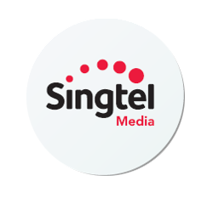
About SingTel Media
SingTel subscribers: 4.1 Million
Mobile phone users: 1 Million
SingTel has a share of approximately 51.5% of the mobile market alone. That’s about 4.1 Million subscribers who are targetable for your businesses.
This service allows your business to blast SMS, MMS or email to your target demographics from the SingTel’s database of subscribers.

Slide 3
SingTel Database Information
There are 3 profile segmentation-types. You can broadcast messages to specific consumer-pools who also have common interests, or vehicle and homeowners.
1. Standard profile
Age
Gender
Ethnic Group
District
Housing Type
2. Premium profile
Price Plan
Phone Type
Car Owner
Expat
District 9/10/11
3. Smart profile
Behavioral/Habitual
Mothers
Sports fans
K-pop fans
Drama enthusiasts
Delivery methods: SMS / MMS / Email
SMS & MMS Database size: > 1,000,000
Email Database size: > 850,000
Email open rate: ~ 20%

Slide 4
Standard Profile (Direct push)
Age
Gender
Male: 62%
Female: 38%
Income
Dwelling (Housing type)
HDB: 54%
Private: 46%

Slide 5
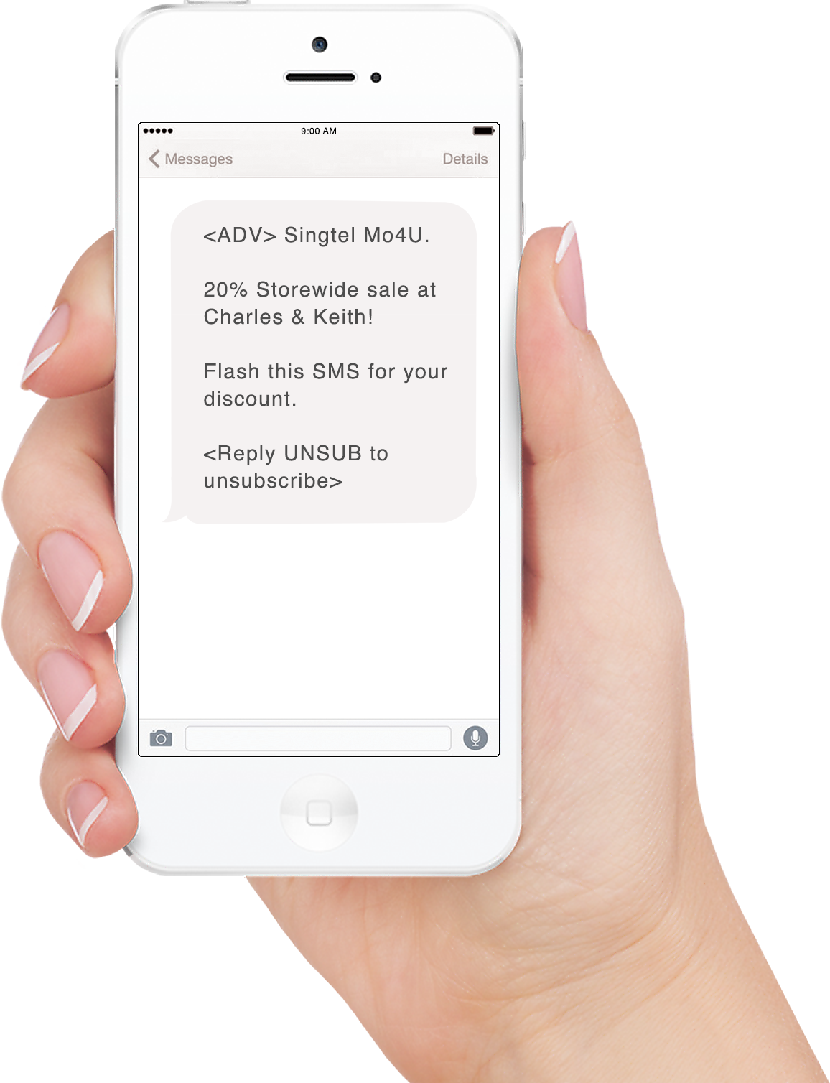
Standard Profile Example
With Standard Profiling, your business can send broadcasts to demographics most fitting to your business.
Target profile chosen by advertiser.
Gender: Female
Age range: 24 - 49
On the right, is an example SMS message broadcasted to Females, aged between 25-49. With Standard Profiling, your business can notify your target audience of the latest promotions directly.

Slide 6
Premium Profile (Direct push)
1. Car Owners
5% (23% owns a car > 4 years)
2. Handset Type
Apple iOS: 35%
Android: 32%
Windows: 2%
3. With children ages 12 and below
16%
Casual travellers
35%
Bill size
Less than $20: 11%
$20 to $50: 37%
$50 to $70: 19%
More than $70: 34%

Slide 7
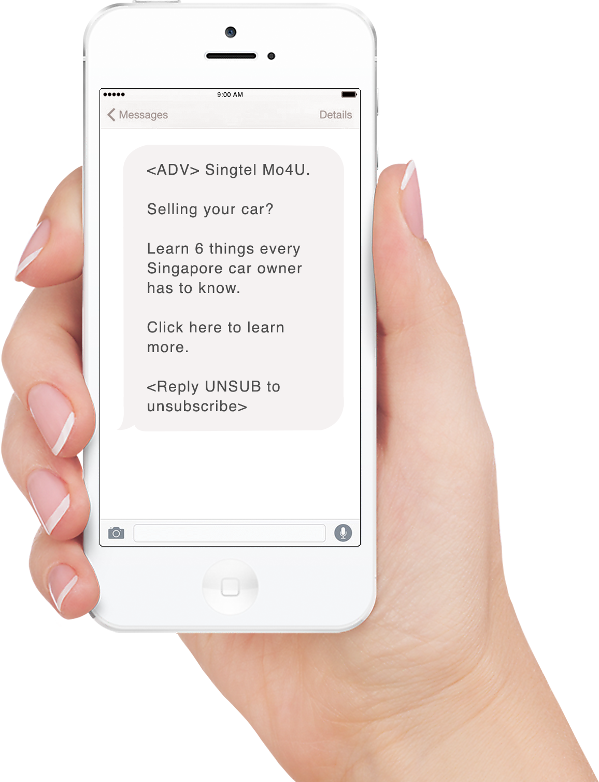
Premium Profile Example
Premium Profiling enables your business to send broadcasts to consumer pools of car-owners, young parents, travelers and more.
Target profile chosen by advertiser.
Car owners
On the right, is a message sent to car owners island-wide. Premium profiling connects the business to only targeted groups of car owners - Stimulating brand awareness among the right crowds.

Slide 8
Smart Profile (Direct push)
Target demographics based on Behavioural & Habitual trends
Travel: 42%
Automotive: 28%
Careers: 38%
Pets: 8%
Family & parenting: 3%
Health & fitness: 34%
Food & drink: 48%
Hobbies & interests: 8%
Education: 15%
Law, government & politics: 5%
News: 2%
Personal finance: 32%
Society: 8%
Science: 4%
Sports: 7%
Real estate: 6%
Style & fashion: 12%
Technology & computing: 8%
Shopping: 49%
Home and gardening: 18%

Slide 9
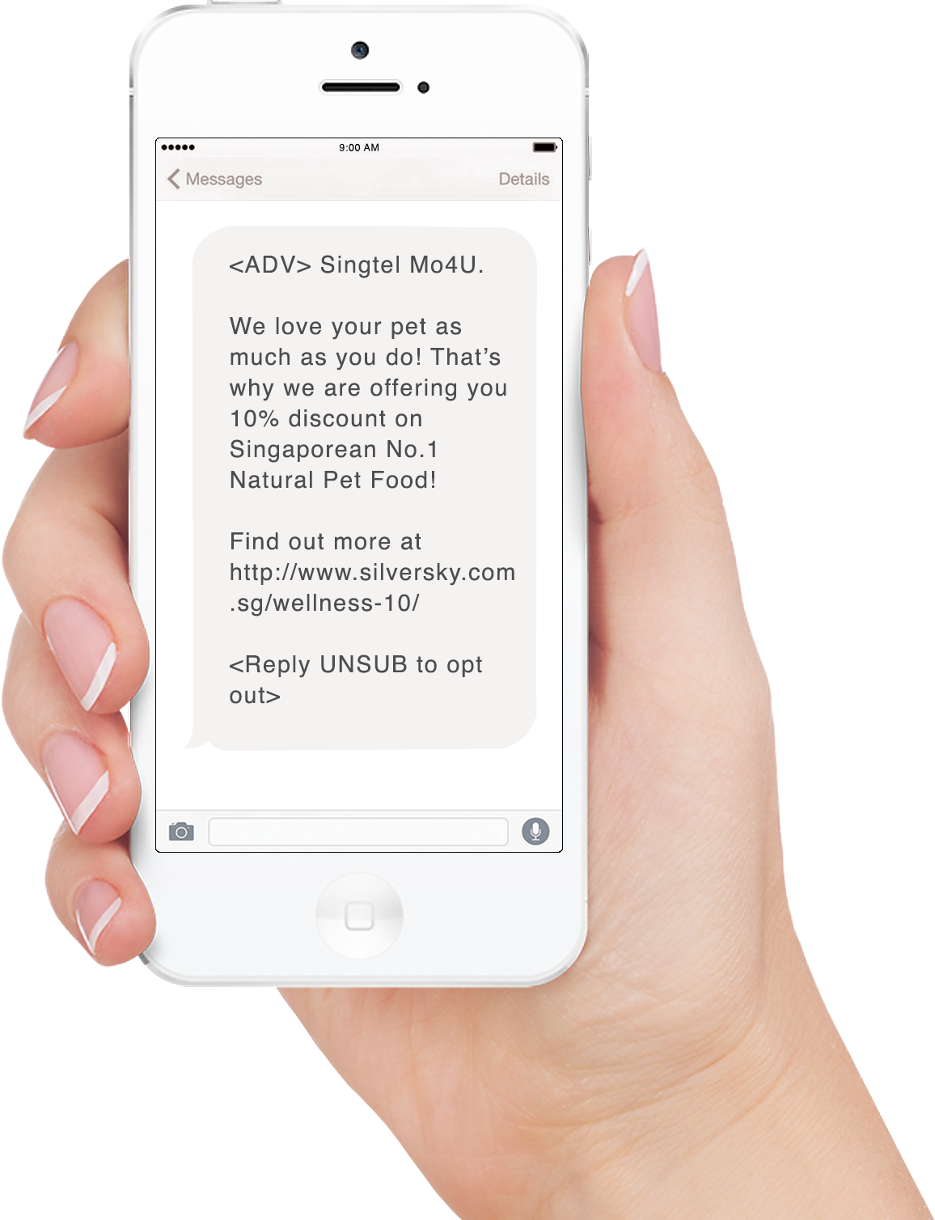
Smart Profile Example
With Smart Profiling, you can zoom in straight to massive consumer-pools who have specific interests, likes and hobbies.
Target profile chosen by advertiser.
Car owners
On the right, is a fellow advertiser, Silversky, who is trading pet food. Using Smart targeting, Silversky can broadcast their offer to thousands of pet lovers; who are most inclined to purchase pet food.

Slide 10
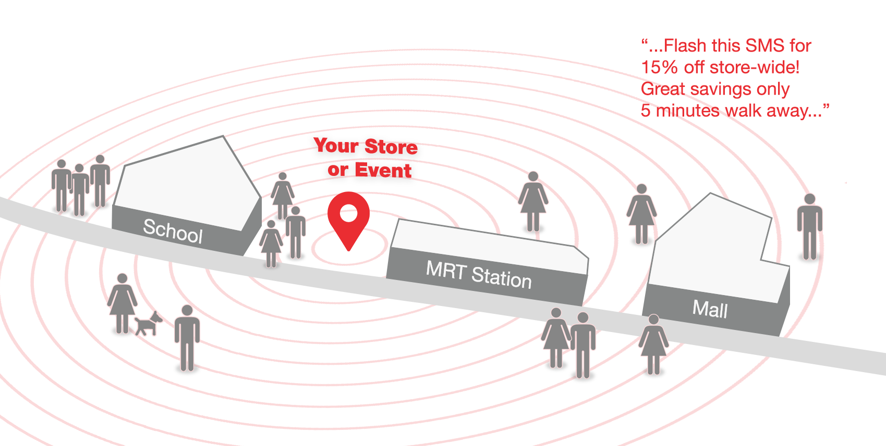
Location Based Ads (Live-location targeted)
With Location-based Advertising, you can broadcast your message to profiled SingTel subscribers within a radius of your selected area.
Target by:
Shopping Malls
Outdoor Zone
Hotels & Resorts
MRT/ LRT Stations
Petrol Stations
Schools
Postal Codes
Hospital / Polyclinics
Broadcast radius: 5 – 10 meters. SingTel users within the proximity of your target area will receive your marketing message.
Usher qualified prospects right into your place of business with a well-timed message convenient to their current locations.

Slide 11
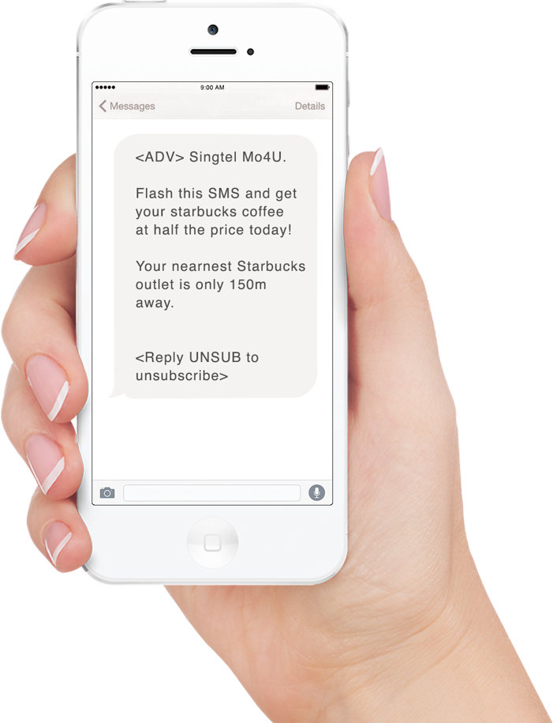
Location Based Ads Example
Use LBA to create instant and well-timed touch-points with the correct consumer crowds fit for your business.
Target profile chosen by advertiser.
Vivo city, Harbour font MRT
Suitable for:
Mealtime discounts for lunch & dinner crowds
Coffee promotions during lunch hours
Notifications of nearby IT / food / game expos
Seminars and tradeshows announcements
Flash sales for retail stores and pushcarts

Slide 12
Details
Title | Specifications
Data source | SingTel’s Post-paid mobile phone line subscribers
Recommended | B2B businesses, B2C businesses, property agents, Educational institutes, FMCG
Sender ID | Sender ID will be by SingTel
Segmentation | Age Gender Ethnic Group District Housing Type

Slide 13
Pricings: SMS & EDM
Description | Cost
Data mining fee | Standard | Premium | Smart | LBA
 | $500 | $1,000 - $2,000 | S2,500 | $500
Database size | More than 1,000,000 (DNC cleared)
Sender ID | Sender ID by SingTel
20,000 – 100,000 (SMS) 255 characters / SMS | $0.35/sms (Additional $0.05/Profile/msg) | Additional $0.25/Profile/msg | Additional $0.50/Profile/msg | $0.40/SMS
20,000 – 100,000 (EDM) | $0.30/eDM (Additional $0.05/Profile/msg) | Additional $0.20/Profile/msg | N.A. | N.A.
SmsDome Bonus | Complimentary 10% additional volume
DNC provision: 2 compulsory information to include | Company name Company telephone number or email

Slide 14

Summary
Because of the yearly phone-line updates by SingTel subscribers, SingTel upkeeps a regularly updated database of customers.
This enables businesses to more accurately target the correct consumer-pools; boosting conversions and improving ROI.

Slide 15


Thank you!
SmsDome Help Desk
Mobile/WhatsApp: 9771 2594
Jordan.loo@smsdome.com
SmsDome Pte Ltd
A: 47 Jalan Pemimpin, Halcyon 2, #03-01, Singapore 577200

